Slide 1




MA CARMEN
From: Dhay

Slide 2

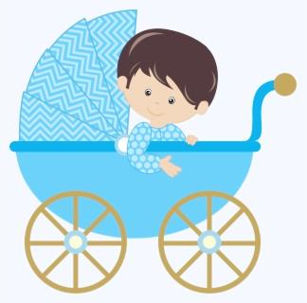

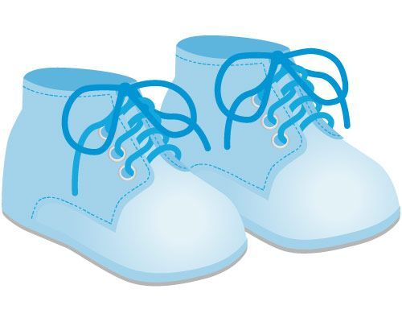
Welcome to the world, baby
Flynn Xavier

Slide 3


From: Family

Slide 4

Happy 7th B-day
2
KEN

Slide 5


Bon Voyage

Slide 6
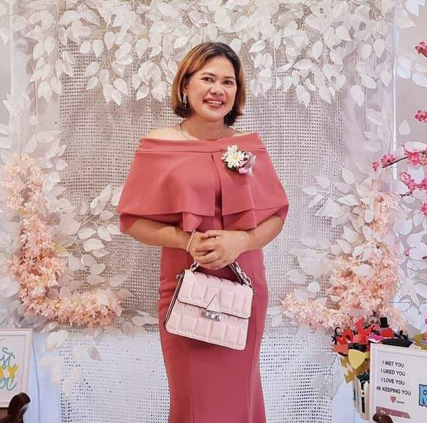





MOMMY
Happy Birthday!

Slide 7


Happy 52nd Birthday Mama!!!

Slide 8

From: Family

Slide 9
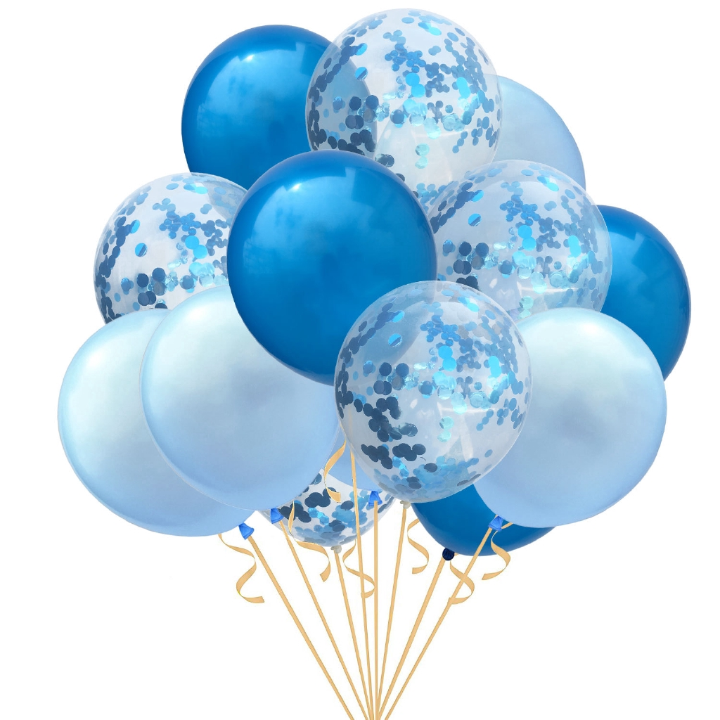

Happy18thBirthday

Slide 10
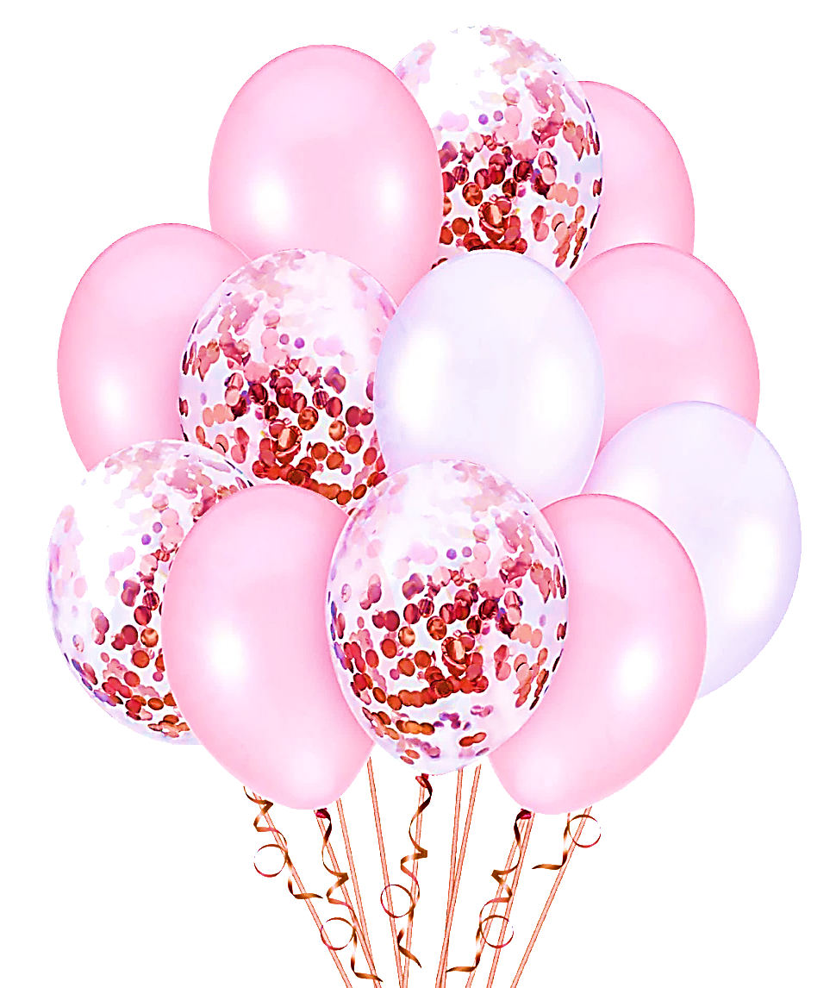



Slide 11
Bal
Happy 51st Birthday!!!
Happy 71st Birthday!!!

Slide 12







ULY
HAPPY
BIRTHDAY

Slide 13








Happy Birthday

Slide 14
JOYCE MAE

Slide 15
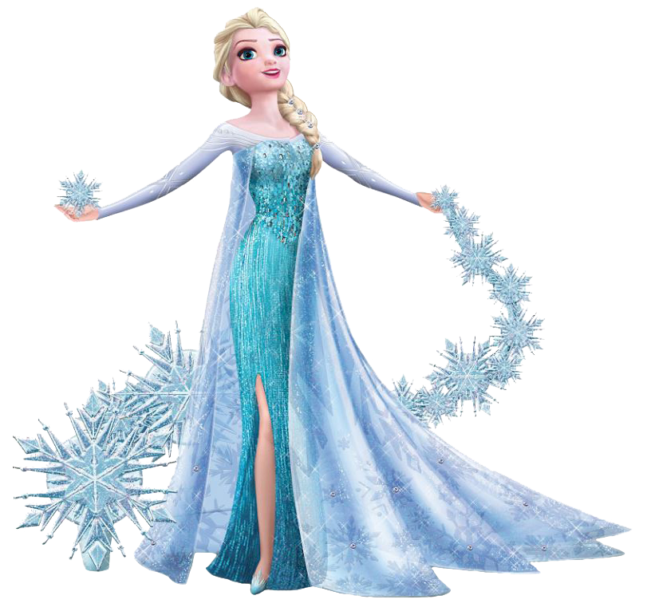
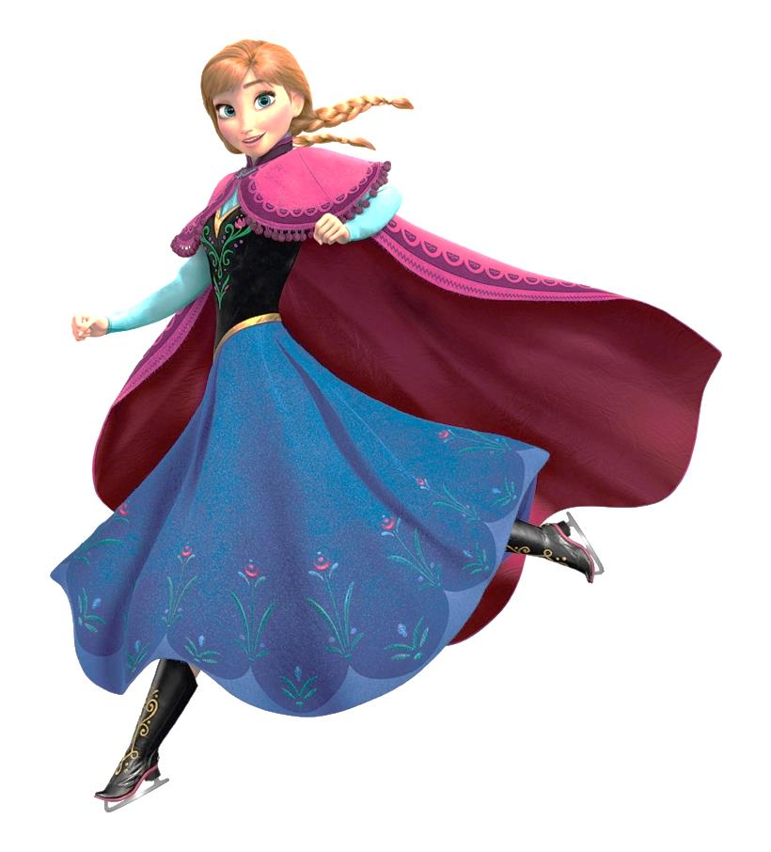



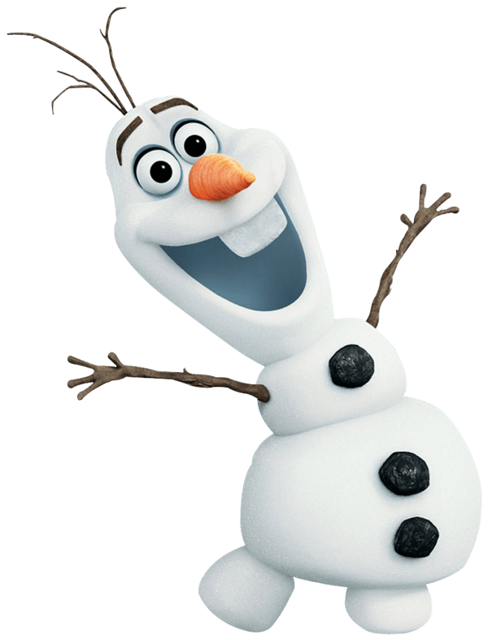


3
Stephanie @
From: Ninang Nevalugin

Slide 16

CHIEF
RIEL

Slide 17
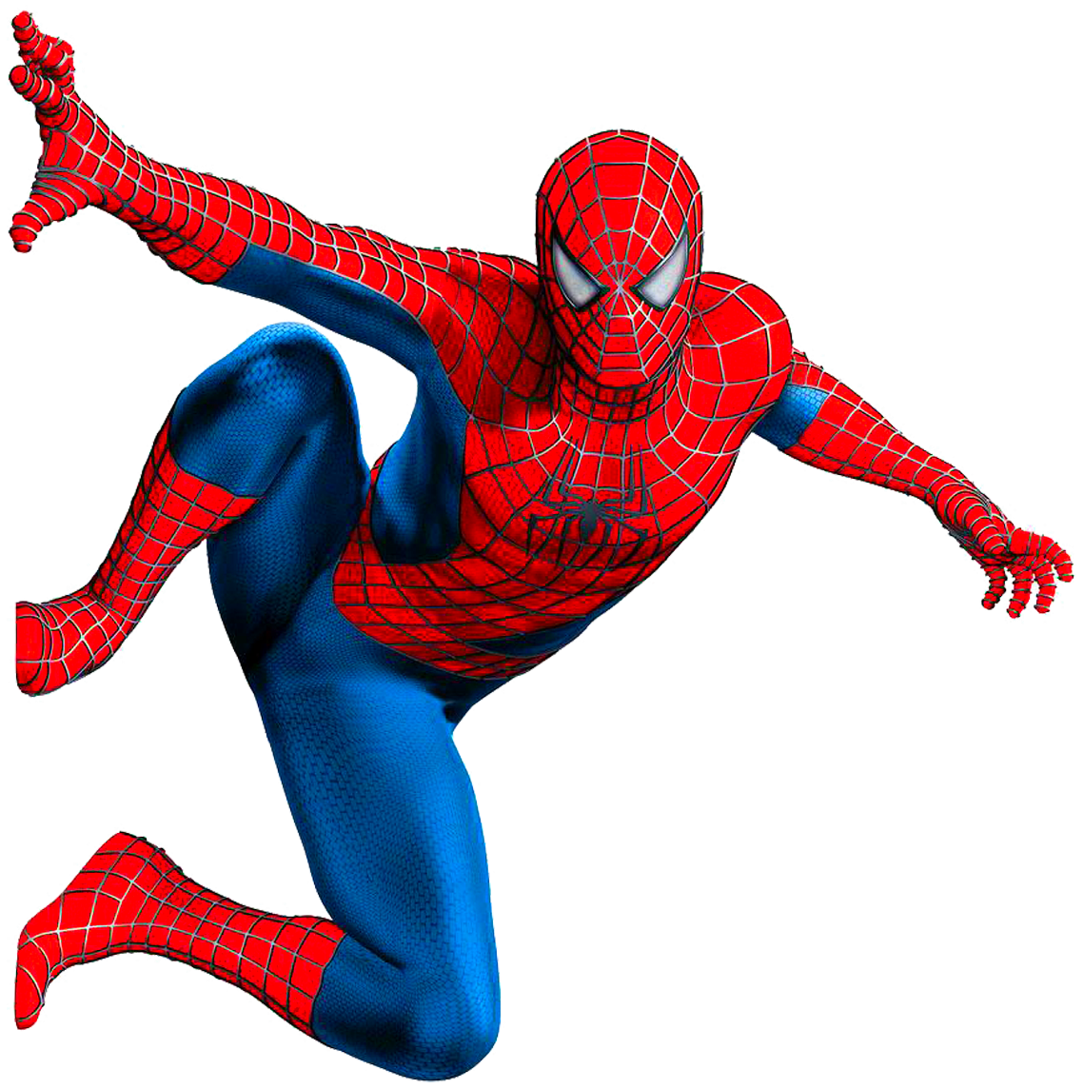
4
th
Happy
Birthday
C-JAY

Slide 18
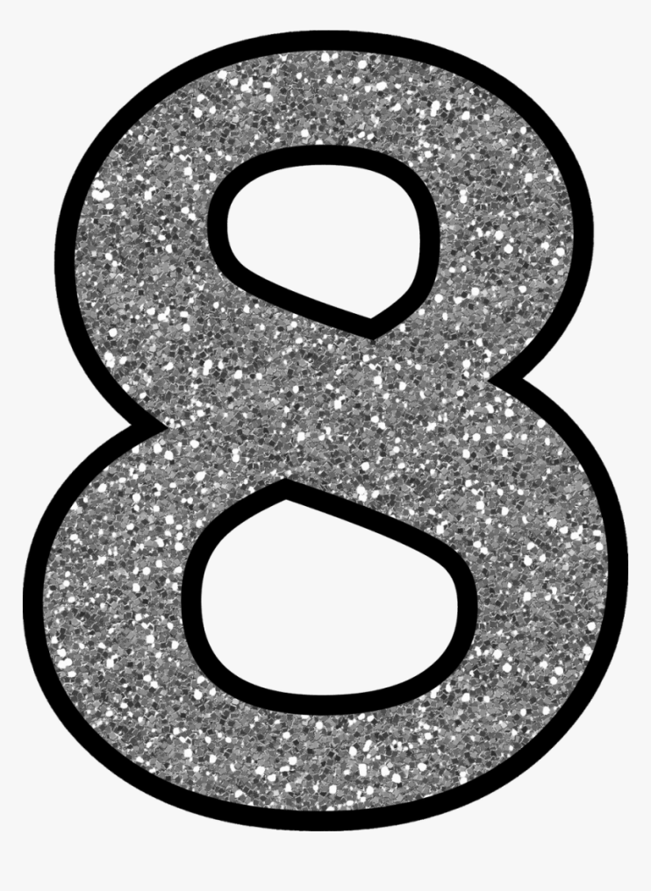


Jhonard 129

Slide 19
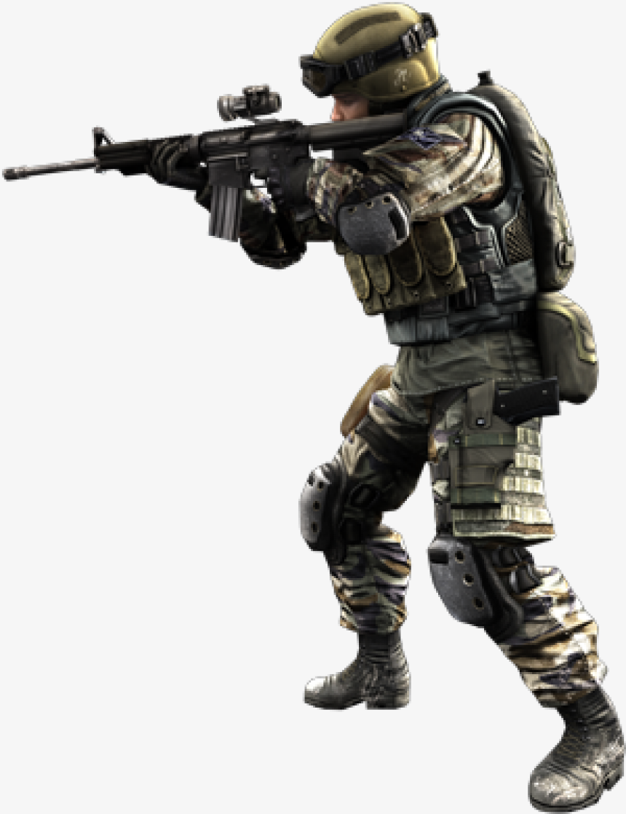






Slide 20





Slide 21
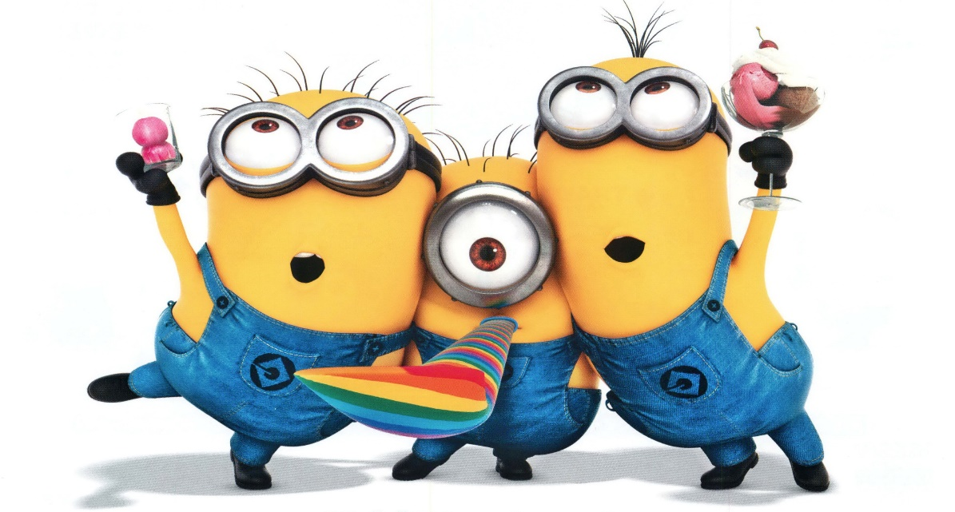


Happy 7th B-day, JHAE!

Slide 22


Happy Christening,
LA Travis

Slide 23



